Slide 1
Big Data Applications, Software, Hardware and Curricula
Federal Big Data Working Group Meetup
March 2 , 2015
March 2 2015
Geoffrey Fox
gcf@indiana.edu
http://www.infomall.org
School of Informatics and Computing
Digital Science Center
Indiana University Bloomington

Slide 2
Data Science MOOC and Curriculum

Slide 3
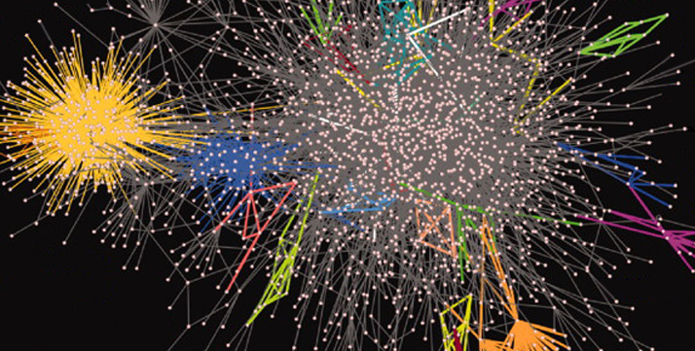
SOIC Data Science Program
Cross Disciplinary Faculty – 31 in School of Informatics and Computing, a few in statistics and expanding across campus
Affordable online and traditional residential curricula or mix thereof
Masters, Certificate, PhD Minor in place; Full PhD being studied
http://www.soic.indiana.edu/graduate/degrees/data-science/index.html

Slide 4
IU Data Science Program
Program managed by cross disciplinary Faculty in Data Science. Currently Statistics and Informatics and Computing School but will expand scope to full campus
A purely online 4-course Certificate in Data Science has been running since January 2014 (with 70 students total in 2 semesters)
4 students got certificate end of last semester
Most students are professionals taking courses in “free time”
A campus wide Ph.D. Minor in Data Science has been approved.
Exploring PhD in Data Science
Courses labelled as “Decision-maker” and “Technical” paths where McKinsey says an order of magnitude more (1.5 million by 2018) unmet job openings in Decision-maker track

Slide 5
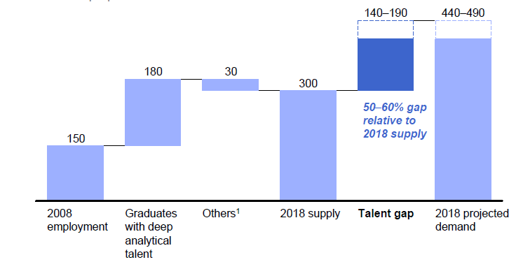
McKinsey Institute on Big Data Jobs
http://www.mckinsey.com/mgi/publications/big_data/index.asp
There will be a shortage of talent necessary for organizations to take advantage of big data. By 2018, the United States alone could face a shortage of 140,000 to 190,000 people with deep analytical skills as well as 1.5 million managers and analysts with the know-how to use the analysis of big data to make effective decisions.
IU Data Science Decision Maker Path aimed at 1.5 million jobs. Technical Path covers the 140,000 to 190,000

Slide 6
IU Data Science Program: Masters
Masters Fully approved by University and State October 14 2014 and starts January 2015
Blended online and residential (any combination)
Online offered at in-state rates (~$1100 per course)
Informatics, Computer Science, Information and Library Science in School of Informatics and Computing and the Department of Statistics, College of Arts and Science, IUB
30 credits (10 conventional courses)
Basic (general) Masters degree plus tracks
Currently only track is “Computational and Analytic Data Science ”
Other tracks expected such as Biomedical Data Science

Slide 7
Online Data Science Classes
Big Data Applications & Analytics
~40 hours of video mainly discussing applications (The X in X-Informatics or X-Analytics) in context of big data and clouds https://bigdatacourse.appspot.com/course
Big Data Open Source Software and Projects http://bigdataopensourceprojects.soic.indiana.edu/
~15 Hours of video discussing HPC-ABDS and use on FutureSystems in Big Data software (being upgraded)
Both divided into sections (coherent topics), units (~lectures) and lessons (5-20 minutes) where student is meant to stay awake

Slide 8
Big Data Applications & Analytics Topics
1 Unit: Organizational Introduction
1 Unit: Motivation: Big Data and the Cloud; Centerpieces of the Future Economy
3 Units: Pedagogical Introduction: What is Big Data, Data Analytics and X-Informatics
SideMOOC: Python for Big Data Applications and Analytics: NumPy, SciPy, MatPlotlib
SideMOOC: Using FutureSystems for Java and Python
4 Units: X-Informatics with X= LHC Analysis and Discovery of Higgs particle
Integrated Technology: Explore Events; histograms and models; basic statistics (Python and some in Java)
3 Units on a Big Data Use Cases Survey
SideMOOC: Using Plotviz Software for Displaying Point Distributions in 3D
3 Units: X-Informatics with X= e-Commerce and Lifestyle
Technology (Python or Java): Recommender Systems - K-Nearest Neighbors
Technology: Clustering and heuristic methods
1 Unit: Parallel Computing Overview and familiar examples
4 Units: Cloud Computing Technology for Big Data Applications & Analytics
2 Units: X-Informatics with X = Web Search and Text Mining and their technologies
Technology for Big Data Applications & Analytics : Kmeans (Python/Java)
Technology for Big Data Applications & Analytics: MapReduce
Technology for Big Data Applications & Analytics : Kmeans and MapReduce Parallelism (Python/Java)
Technology for Big Data Applications & Analytics : PageRank (Python/Java)
3 Units: X-Informatics with X = Sports
1 Unit: X-Informatics with X = Health
1 Unit: X-Informatics with X = Internet of Things & Sensors
1 Unit: X-Informatics with X = Radar for Remote Sensing
Red = Software

Slide 9
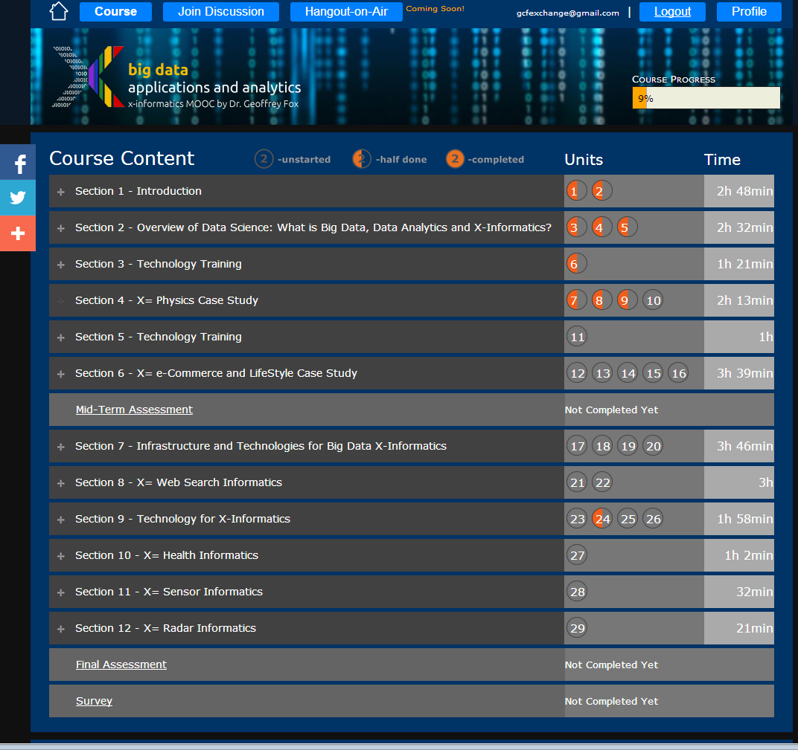
Example Google
Course Builder MOOC
4 levels
Course
Section (12)
Units(29)
Lessons(~150)
Units are roughly traditional lecture
Lessons are ~10 minute segments
http://x-informatics.appspot.com/course

Slide 10
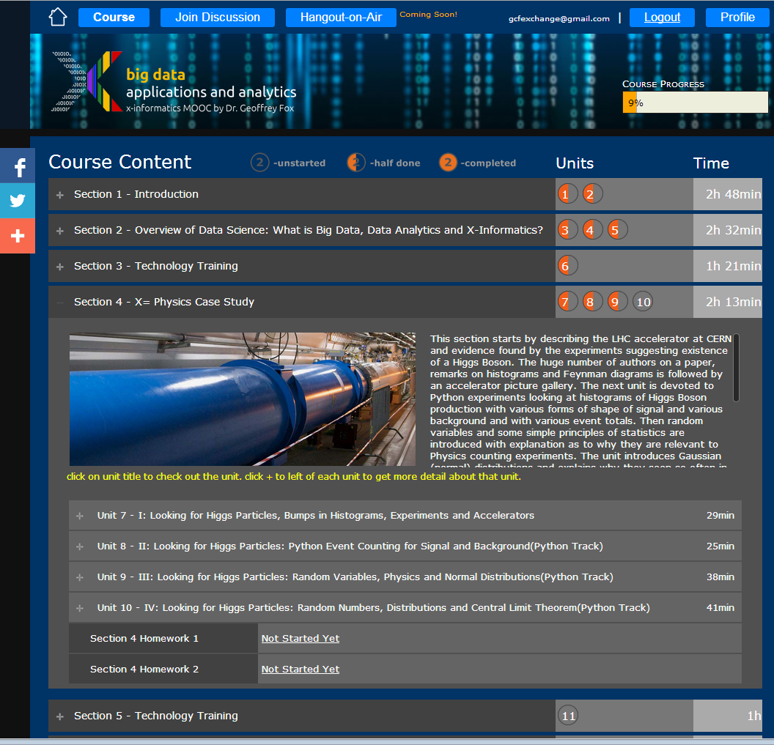
Example Google
Course Builder
MOOC
The Physics Section expands to 4 units and 2 Homeworks
Unit 9 expands to 5 lessons
Lessons played on YouTube
“talking head video + PowerPoint”
http://x-informatics.appspot.com/course

Slide 11
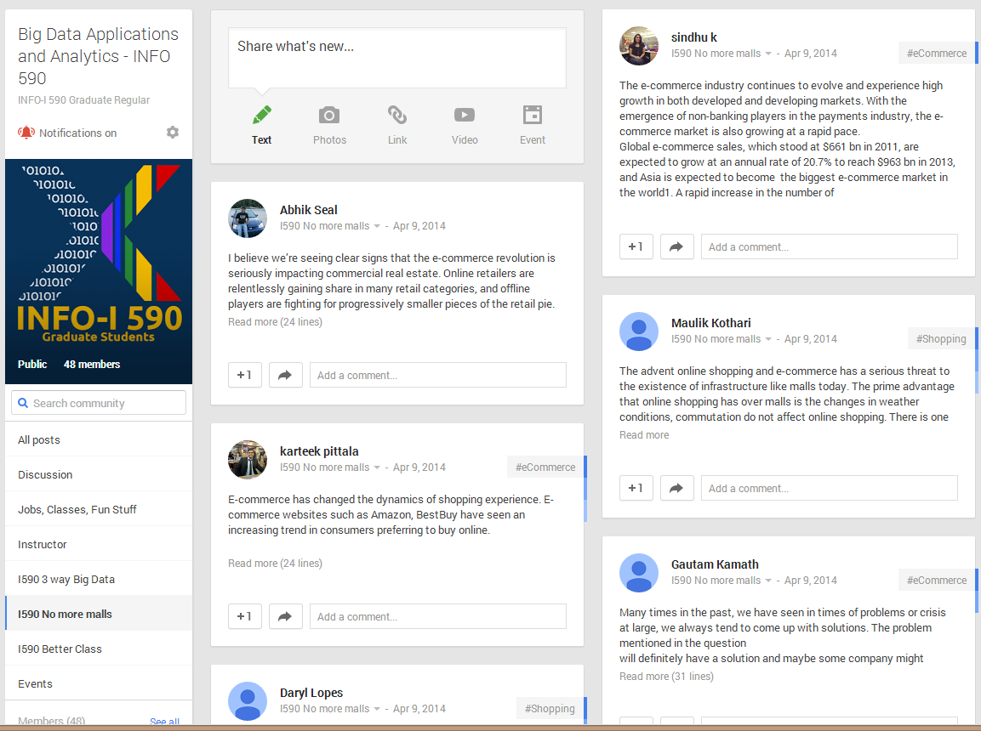
The community group for one of classes and one forum (“No more malls”)

Slide 12
Big Data & Open Source Software Projects Overview I
This course studies software used in many commercial activities to study Big Data. The backdrop for course is the ~300 software subsystems illustrated at http://hpc-abds.org/kaleidoscope/. We will describe the software architecture represented by this collection which we term HPC-ABDS (High Performance Computing enhanced - Apache Big Data Stack).
The cloud computing architecture underlying ABDS and contrast of this with HPC.
The software architecture with its different layers at http://hpc-abds.org/kaleidoscope/ covering broad functionality and rationale for each layer.
Then we will go through selected software systems – about 5% of those in the Kaleidoscope which have been already deployed on FutureSystems cloud using OpenStack and Chef recipes.
Students will chose one or more other open source member of Kaleidoscope each and deploy as illustrated in class
The main activity of the course will be building a significant project using multiple HPC-ABDS subsystems combined with user code and data.
Projects will be suggested or students can chose their own
For more information, see: http://bigdataopensourceprojects.soic.indiana.edu/ (will be updated March April 2015)

Slide 13
Big Data & Open Source Software Projects Overview II
Prerequisites
Elementary knowledge in a scripting language needed (if not available this can be acquired as part of this course)
Basic knowledge of Python desirable (if not available this can be acquired as part of this course)
Ability to (learn to) use the Linux/Unix command shell (we will have lesson on this)
Basic understanding on how to install packages and programs on Linux (we will have a lesson on this)
You will learn
DevOps: "software deployment automation"
Linux command shell and Elementary usage of ssh
Use of Github to store software packages and documentation
The reproducible installation of sophisticated platforms on virtual clusters.
This is facilitated either by scripts developed in Python, Openstack Heat, or a DevOps framework such as Ansible, Chef, or Puppet.
Which framework is chosen will depend on the experience level of the student.
You will learn utility of the key parts of Big Data Stack

Slide 14
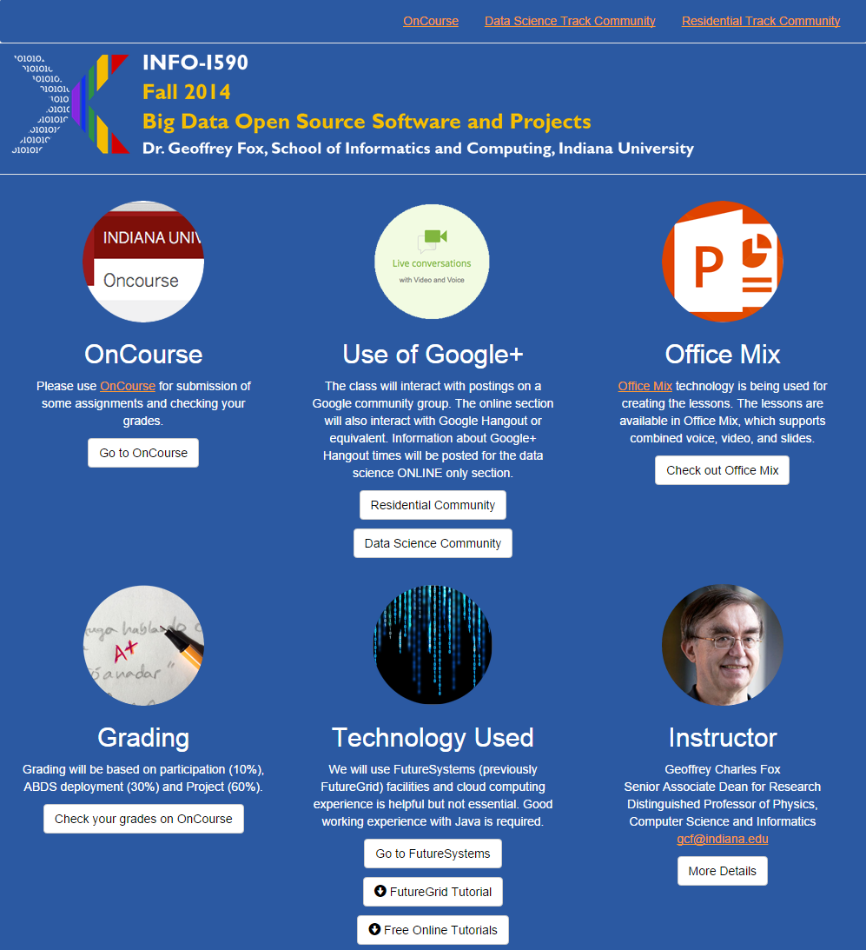
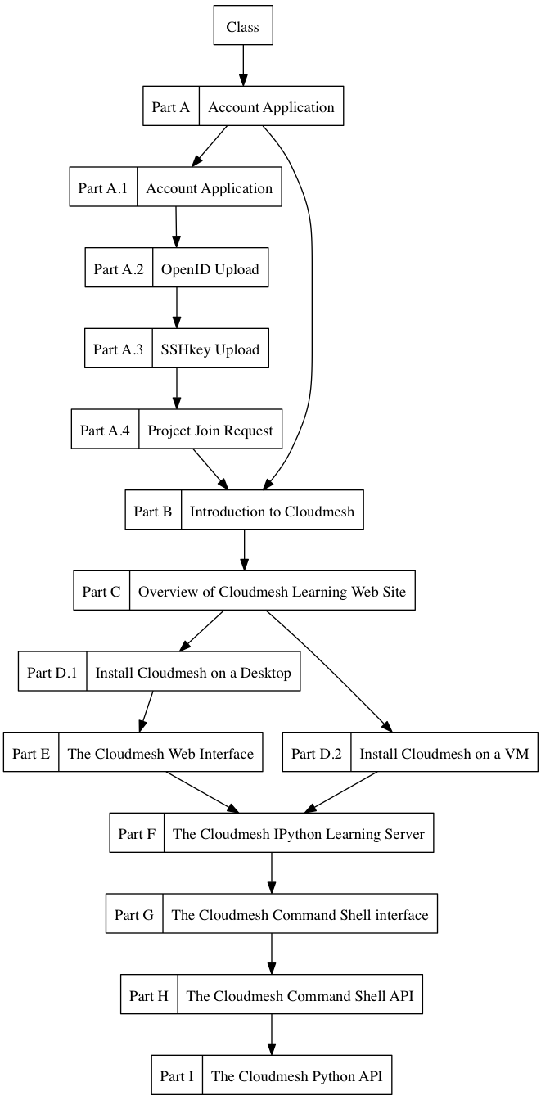
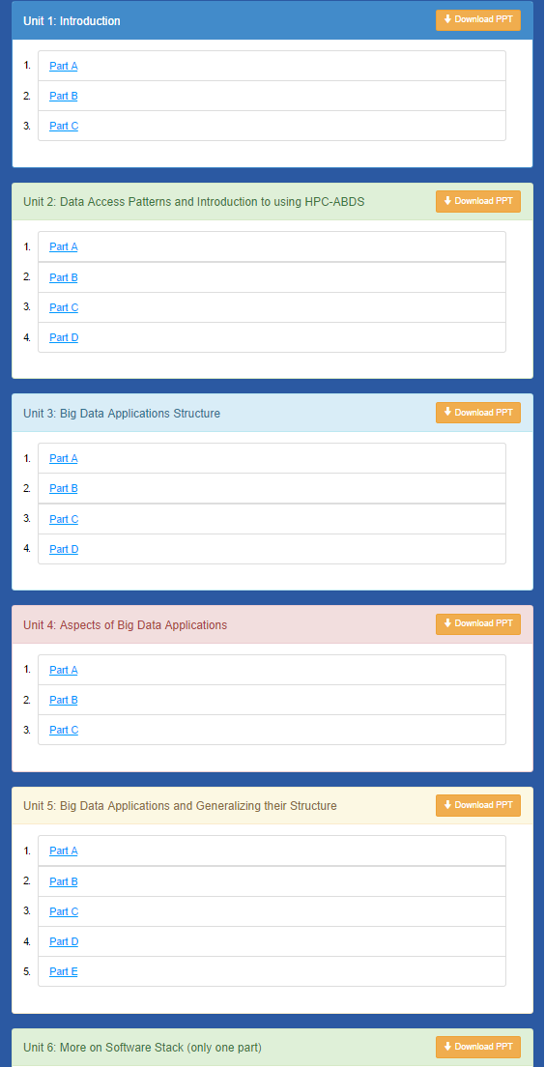
Cloudmesh MOOC Videos
http://bigdataopensourceprojects.soic.indiana.edu/

Slide 15
Potpourri of Online Technologies
Canvas (Indiana University Default): Best for interface with IU grading and records
Google Course Builder: Best for management and integration of components
Ad hoc web pages: alternative easy to build integration
Microsoft Mix: Simplest faculty preparation interface
Adobe Presenter/Camtasia: More powerful video preparation that support subtitles but not clearly needed
Google Community: Good social interaction support
YouTube: Best user interface for videos
Hangout: Best for instructor-students online interactions (one instructor to 9 students with live feed). Hangout on air mixes live and streaming (30 second delay from archived YouTube) and more participants

Slide 16
Online Resources Data Science Curriculum

Slide 18
My Research in Data Science
Identify/develop parallel large scale data analytics data analytics library SPIDAL (Scalable Parallel Interoperable Data Analytics Library ) of similar quality to PETSc and ScaLAPACK which have been very influential in success of HPC for simulations
Analyze Big Data applications to identify analytics needed and generate benchmark applications and characteristics (Ogres with facets)
Analyze existing analytics libraries (in practice limit to some application domains and some general libraries Mahout, R. MLlib) – catalog library members available and performance
Analyze Big Data Software and identify software model HPC-ABDS (HPC – Apache Big Data Stack) to allow interoperability (Cloud/HPC) and high performance merging HPC and commodity cloud software
Identify range of big data computer architectures
Design or identify new or existing algorithms including and assuming parallel implementation
Many more data scientists than computational scientists so HPC implications of data analytics could be influential on simulation software and hardware
Develop Data Science Curricula

Slide 19
Analytics and the DIKW Pipeline
Data goes through a pipeline (Big Data is also Big Wisdom etc.) Raw data → Data → Information → Knowledge → Wisdom → Decisions
Each link enabled by a filter which is “business logic” or “analytics”
All filters are Analytics
However I am most interested in filters that involve “sophisticated analytics” which require non trivial parallel algorithms
Improve state of art in both algorithm quality and (parallel) performance
See Apache Crunch or Google Cloud Dataflow supporting pipelined analytics
And Pegasus, Taverna, Kepler from Grid community
Data
Information
Analytics
Information
Knowledge
More Analytics

Slide 20
There are a lot of Big Data and HPC Software systems in 17 (21) layers
Build on – do not compete with the 293 HPC-ABDS systems
Green implies HPC Integration

Slide 21
NIST Big Data Initiative
Led by Chaitin Baru, Bob Marcus, Wo Chang

Slide 22
NBD-PWG (NIST Big Data Public Working Group) Subgroups & Co-Chairs
There were 5 Subgroups
Note mainly industry
Requirements and Use Cases Sub Group
Geoffrey Fox, Indiana U.; Joe Paiva, VA; Tsegereda Beyene, Cisco
Definitions and Taxonomies SG
Nancy Grady, SAIC; Natasha Balac, SDSC; Eugene Luster, R2AD
Reference Architecture Sub Group
Orit Levin, Microsoft; James Ketner, AT&T; Don Krapohl, Augmented Intelligence
Security and Privacy Sub Group
Arnab Roy, CSA/Fujitsu Nancy Landreville, U. MD Akhil Manchanda, GE
Technology Roadmap Sub Group
Carl Buffington, Vistronix; Dan McClary, Oracle; David Boyd, Data Tactics
See http://bigdatawg.nist.gov/usecases.php
And http://bigdatawg.nist.gov/V1_output_docs.php

Slide 23
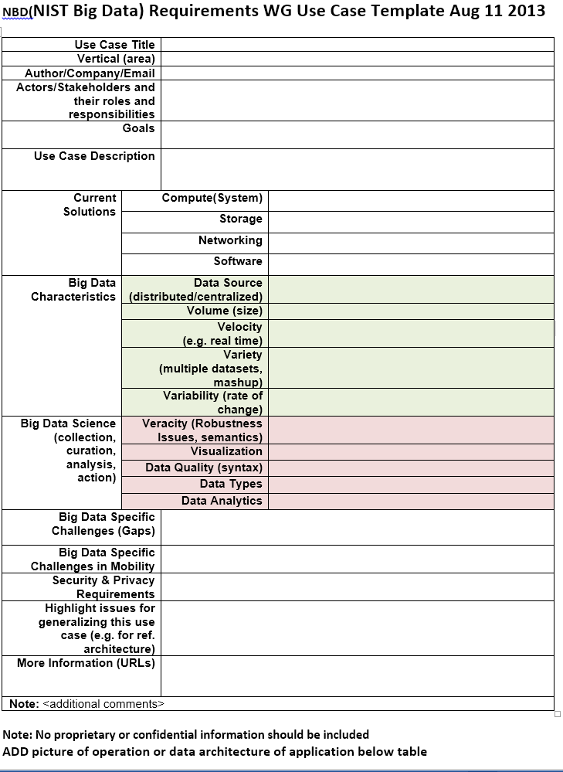
Use Case Template
26 fields completed for 51 areas
Government Operation: 4
Commercial: 8
Defense: 3
Healthcare and Life Sciences: 10
Deep Learning and Social Media: 6
The Ecosystem for Research: 4
Astronomy and Physics: 5
Earth, Environmental and Polar Science: 10
Energy: 1

Slide 24
51 Detailed Use Cases: Contributed July-September 2013 Covers goals, data features such as 3 V’s, software, hardware
26 Features for each use case
Biased to science
http://bigdatawg.nist.gov/usecases.php
https://bigdatacoursespring2014.appspot.com/course (Section 5)
Government Operation(4): National Archives and Records Administration, Census Bureau
Commercial(8): Finance in Cloud, Cloud Backup, Mendeley (Citations), Netflix, Web Search, Digital Materials, Cargo shipping (as in UPS)
Defense(3): Sensors, Image surveillance, Situation Assessment
Healthcare and Life Sciences(10): Medical records, Graph and Probabilistic analysis, Pathology, Bioimaging, Genomics, Epidemiology, People Activity models, Biodiversity
Deep Learning and Social Media(6): Driving Car, Geolocate images/cameras, Twitter, Crowd Sourcing, Network Science, NIST benchmark datasets
The Ecosystem for Research(4): Metadata, Collaboration, Language Translation, Light source experiments
Astronomy and Physics(5): Sky Surveys including comparison to simulation, Large Hadron Collider at CERN, Belle Accelerator II in Japan
Earth, Environmental and Polar Science(10): Radar Scattering in Atmosphere, Earthquake, Ocean, Earth Observation, Ice sheet Radar scattering, Earth radar mapping, Climate simulation datasets, Atmospheric turbulence identification, Subsurface Biogeochemistry (microbes to watersheds), AmeriFlux and FLUXNET gas sensors
Energy(1): Smart grid

Slide 25
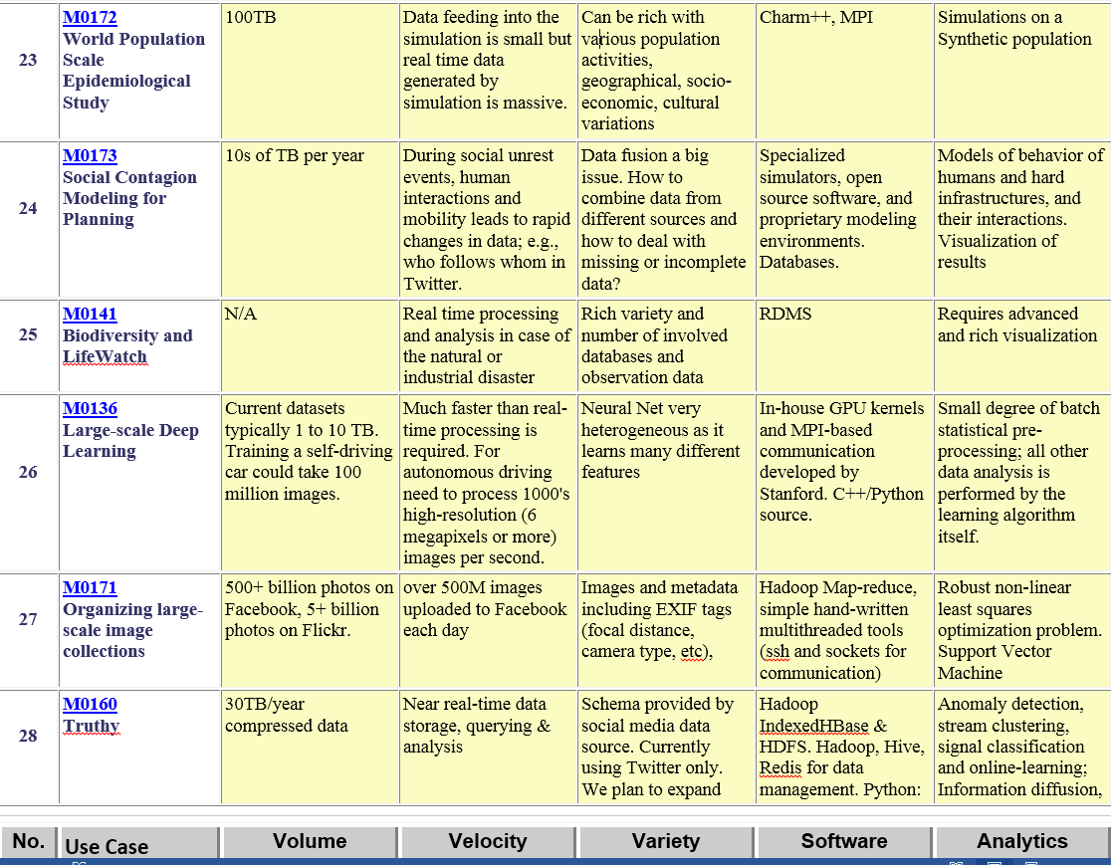
Table 4: Characteristics of 6 Distributed Applications
Application Example | Execution Unit | Communication | Coordination | Execution Environment
Montage | Multiple sequential and parallel executable | Files | Dataflow (DAG) | Dynamic process creation, execution
NEKTAR | Multiple concurrent parallel executables | Stream based | Dataflow | Co-scheduling, data streaming, async. I/O
Replica-Exchange | Multiple seq. and parallel executables | Pub/sub | Dataflow and events | Decoupled coordination and messaging
Climate Prediction (generation) | Multiple seq. & parallel executables | Files and messages | Master-Worker, events | @Home (BOINC)
Climate Prediction (analysis) | Multiple seq. & parallel executables | Files and messages | Dataflow | Dynamics process creation, workflow execution
SCOOP | Multiple Executable | Files and messages | Dataflow | Preemptive scheduling, reservations
Coupled Fusion | Multiple executable | Stream-based | Dataflow | Co-scheduling, data streaming, async I/O
Part of Property Summary Table

Slide 26
Features and Examples

Slide 27
51 Use Cases: What is Parallelism Over?
People: either the users (but see below) or subjects of application and often both
Decision makers like researchers or doctors (users of application)
Items such as Images, EMR, Sequences below; observations or contents of online store
Images or “Electronic Information nuggets”
EMR: Electronic Medical Records (often similar to people parallelism)
Protein or Gene Sequences;
Material properties, Manufactured Object specifications, etc., in custom dataset
Modelled entities like vehicles and people
Sensors – Internet of Things
Events such as detected anomalies in telescope or credit card data or atmosphere
(Complex) Nodes in RDF Graph
Simple nodes as in a learning network
Tweets, Blogs, Documents, Web Pages, etc.
And characters/words in them
Files or data to be backed up, moved or assigned metadata
Particles/cells/mesh points as in parallel simulations

Slide 28
Features of 51 Use Cases I
PP (26) “All” Pleasingly Parallel or Map Only
MR (18) Classic MapReduce MR (add MRStat below for full count)
MRStat (7) Simple version of MR where key computations are simple reduction as found in statistical averages such as histograms and averages
MRIter (23) Iterative MapReduce or MPI (Spark, Twister)
Graph (9) Complex graph data structure needed in analysis
Fusion (11) Integrate diverse data to aid discovery/decision making; could involve sophisticated algorithms or could just be a portal
Streaming (41) Some data comes in incrementally and is processed this way
Classify (30) Classification: divide data into categories
S/Q (12) Index, Search and Query

Slide 29
Features of 51 Use Cases II
CF (4) Collaborative Filtering for recommender engines
LML (36) Local Machine Learning (Independent for each parallel entity) – application could have GML as well
GML (23) Global Machine Learning: Deep Learning, Clustering, LDA, PLSI, MDS,
Large Scale Optimizations as in Variational Bayes, MCMC, Lifted Belief Propagation, Stochastic Gradient Descent, L-BFGS, Levenberg-Marquardt . Can call EGO or Exascale Global Optimization with scalable parallel algorithm
Workflow (51) Universal
GIS (16) Geotagged data and often displayed in ESRI, Microsoft Virtual Earth, Google Earth, GeoServer etc.
HPC (5) Classic large-scale simulation of cosmos, materials, etc. generating (visualization) data
Agent (2) Simulations of models of data-defined macroscopic entities represented as agents

Slide 30
13 Image-based Use Cases
13-15 Military Sensor Data Analysis/ Intelligence PP, LML, GIS, MR
7:Pathology Imaging/ Digital Pathology: PP, LML, MR for search becoming terabyte 3D images, Global Classification
18&35: Computational Bioimaging (Light Sources): PP, LML Also materials
26: Large-scale Deep Learning: GML Stanford ran 10 million images and 11 billion parameters on a 64 GPU HPC; vision (drive car), speech, and Natural Language Processing
27: Organizing large-scale, unstructured collections of photos: GML Fit position and camera direction to assemble 3D photo ensemble
36: Catalina Real-Time Transient Synoptic Sky Survey (CRTS): PP, LML followed by classification of events (GML)
43: Radar Data Analysis for CReSIS Remote Sensing of Ice Sheets: PP, LML to identify glacier beds; GML for full ice-sheet
44: UAVSAR Data Processing, Data Product Delivery, and Data Services: PP to find slippage from radar images
45, 46: Analysis of Simulation visualizations: PP LML ?GML find paths, classify orbits, classify patterns that signal earthquakes, instabilities, climate, turbulence

Slide 31
Internet of Things and Streaming Apps
It is projected that there will be 24 (Mobile Industry Group) to 50 (Cisco) billion devices on the Internet by 2020.
The cloud natural controller of and resource provider for the Internet of Things.
Smart phones/watches, Wearable devices (Smart People), “Intelligent River” “Smart Homes and Grid” and “Ubiquitous Cities”, Robotics.
Majority of use cases are streaming – experimental science gathers data in a stream – sometimes batched as in a field trip. Below is sample
10: Cargo Shipping Tracking as in UPS, Fedex PP GIS LML
13: Large Scale Geospatial Analysis and Visualization PP GIS LML
28: Truthy: Information diffusion research from Twitter Data PP MR for Search, GML for community determination
39: Particle Physics: Analysis of LHC Large Hadron Collider Data: Discovery of Higgs particle PP Local Processing Global statistics
50: DOE-BER AmeriFlux and FLUXNET Networks PP GIS LML
51: Consumption forecasting in Smart Grids PP GIS LML

Slide 32
Global Machine Learning aka EGO – Exascale Global Optimization
Typically maximum likelihood or χ² with a sum over the N data items – documents, sequences, items to be sold, images etc. and often links (point-pairs).
Usually it’s a sum of positive numbers as in least squares
Covering clustering/community detection, mixture models, topic determination, Multidimensional scaling, (Deep) Learning Networks
PageRank is “just” parallel linear algebra
Note many Mahout algorithms are sequential – partly as MapReduce limited; partly because parallelism unclear
MLLib (Spark based) better
SVM and Hidden Markov Models do not use large scale parallelization in practice?
Some overlap/confusion with with graph analytics

Slide 33
Big Data Patterns – the Ogres

Slide 34
7 Computational Giants of NRC Massive Data Analysis Report
http://www.nap.edu/catalog.php?record_id=18374
G1: Basic Statistics e.g. MRStat
G2: Generalized N-Body Problems
G3: Graph-Theoretic Computations
G4: Linear Algebraic Computations
G5: Optimizations e.g. Linear Programming
G6: Integration e.g. LDA and other GML
G7: Alignment Problems e.g. BLAST

Slide 35
HPC Benchmark Classics
Linpack or HPL: Parallel LU factorization for solution of linear equations
NPB version 1: Mainly classic HPC solver kernels
MG: Multigrid
CG: Conjugate Gradient
FT: Fast Fourier Transform
IS: Integer sort
EP: Embarrassingly Parallel
BT: Block Tridiagonal
SP: Scalar Pentadiagonal
LU: Lower-Upper symmetric Gauss Seidel

Slide 36
13 Berkeley Dwarfs
Dense Linear Algebra
Sparse Linear Algebra
Spectral Methods
N-Body Methods
Structured Grids
Unstructured Grids
MapReduce
Combinational Logic
Graph Traversal
Dynamic Programming
Backtrack and Branch-and-Bound
Graphical Models
Finite State Machines
First 6 of these correspond to Colella’s original.
Monte Carlo dropped.
N-body methods are a subset of Particle in Colella.
Note a little inconsistent in that MapReduce is a programming model and spectral method is a numerical method.
Need multiple facets!

Slide 37
Facets of the Ogres

Slide 38
Introducing Big Data Ogres and their Facets I
Big Data Ogres provide a systematic approach to understanding applications, and as such they have facets which represent key characteristics defined both from our experience and from a bottom-up study of features from several individual applications.
The facets capture common characteristics (shared by several problems)which are inevitably multi-dimensional and often overlapping.
Ogres characteristics are cataloged in four distinct dimensions or views.
Each view consists of facets; when multiple facets are linked together, they describe classes of big data problems represented as an Ogre.
Instances of Ogres are particular big data problems
A set of Ogre instances that cover a rich set of facets could form a benchmark set
Ogres and their instances can be atomic or composite

Slide 39
Introducing Big Data Ogres and their Facets II
Ogres characteristics are cataloged in four distinct dimensions or views.
Each view consists of facets; when multiple facets are linked together, they describe classes of big data problems represented as an Ogre.
One view of an Ogre is the overall problem architecture which is naturally related to the machine architecture needed to support data intensive application while still being different.
Then there is the execution (computational) features view, describing issues such as I/O versus compute rates, iterative nature of computation and the classic V’s of Big Data: defining problem size, rate of change, etc.
The data source & style view includes facets specifying how the data is collected, stored and accessed.
The final processing view has facets which describe classes of processing steps including algorithms and kernels. Ogres are specified by the particular value of a set of facets linked from the different views.

Slide 40
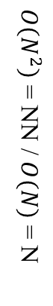
14
$O\left(N^{2}\right)$ = NN / $O(N)$ = N
Shared / Dedicated / Transient / Permanent
13
Metric = M / Non-Metric = N
12
Data Abstraction
11
Iterative / Simple
Execution View
Regular = R / Irregular = I
10
Geospatial Information System
Archived/Batched/Streaming
9
Dynamic = D / Static = S
8
Communication Structure
Metadata/Provenance
Enterprise Data Model
SQL/NoSQL/NewSQL
7
Veracity
HDFS/Lustre/GPFS
6
Variety
HPC Simulations
5
Velocity
Internet of Things
4
Volume
Files/Objects
3
Execution Environment; Core libraries
Flops per Byte; Memory I/O
2
Flops/Byte
1
Performance Metrics
4 Ogre Views and 50 Facets
8
10
11
12
1
2
3
4
5
6
7
9
10
9
8
7
6
5
4
3
2
1
Single Program Multiple Data
Bulk Synchronous Parallel
Micro-benchmarks
Problem
Architecture
View
1
Local Analytics
2
Classic MapReduce
Map Point-to-Point
Global Analytics
Pleasingly Parallel
3
Map-Collective
Map Streaming
Shared Memory
Optimization Methodology
4
Visualization
5
Dataflow
Workflow
Data Source and Style View
Alignment
6
Fusion
Agents
Streaming
7
Basic Statistics
8
Search / Query / Index
9
Recommender Engine
10
Classification
11
Deep Learning
12
Processing View
Graph Algorithms
13
Linear Algebra Kernels
14

Slide 41
Facets of the Ogres Meta or Macro Aspects: Problem Architecture

Slide 42
Problem Architecture View of Ogres (Meta or MacroPatterns)
Pleasingly Parallel – as in BLAST, Protein docking, some (bio-)imagery including Local Analytics or Machine Learning – ML or filtering pleasingly parallel, as in bio-imagery, radar images (pleasingly parallel but sophisticated local analytics)
Classic MapReduce: Search, Index and Query and Classification algorithms like collaborative filtering (G1 for MRStat in Features, G7)
Map-Collective: Iterative maps + communication dominated by “collective” operations as in reduction, broadcast, gather, scatter. Common datamining pattern
Map-Point to Point: Iterative maps + communication dominated by many small point to point messages as in graph algorithms
Map-Streaming: Describes streaming, steering and assimilation problems
Shared Memory: Some problems are asynchronous and are easier to parallelize on shared rather than distributed memory – see some graph algorithms
SPMD: Single Program Multiple Data, common parallel programming feature
BSP or Bulk Synchronous Processing: well-defined compute-communication phases
Fusion: Knowledge discovery often involves fusion of multiple methods.
Dataflow: Important application features often occurring in composite Ogres
Use Agents: as in epidemiology (swarm approaches)
Workflow: All applications often involve orchestration (workflow) of multiple components
Note problem and machine architectures are related
Notes:
Big dwarfs are Ogres
Implement Ogres in ABDS+

Slide 43
Hardware, Software, Applications
In my old papers (especially book Parallel Computing Works!), I discussed computing as multiple complex systems mapped into each other Problem → Numerical formulation → Software → Hardware
Each of these 4 systems has an architecture that can be described in similar language
One gets an easy programming model if architecture of problem matches that of Software
One gets good performance if architecture of hardware matches that of software and problem
So “MapReduce” can be used as architecture of software (programming model) or “Numerical formulation of problem”

Slide 44
6 Forms of MapReduce
PP
Local Analytics
MR Basic Statistics
Iterative
Graph
Streaming
Shared Memory

Slide 45
8 Data Analysis Problem Architectures
1) Pleasingly Parallel PP or “map-only” in MapReduce
BLAST Analysis; Local Machine Learning
2A) Classic MapReduce MR, Map followed by reduction
High Energy Physics (HEP) Histograms; Web search; Recommender Engines
2B) Simple version of classic MapReduce MRStat
Final reduction is just simple statistics
3) Iterative MapReduce MRIter
Expectation maximization Clustering Linear Algebra, PageRank
4A) Map Point to Point Communication
Classic MPI; PDE Solvers and Particle Dynamics; Graph processing Graph
4B) GPU (Accelerator) enhanced 4A) – especially for deep learning
5) Map + Streaming + Communication
Images from Synchrotron sources; Telescopes; Internet of Things IoT
6) Shared memory allowing parallel threads which are tricky to program but lower latency
Difficult to parallelize asynchronous parallel Graph Algorithms

Slide 46
There are a lot of Big Data and HPC Software systems in 17 (21) layers
Build on – do not compete with the 293 HPC-ABDS systems
Green implies HPC Integration

Slide 47
Functionality of 21 HPC-ABDS Layers
Message Protocols:
Distributed Coordination:
Security & Privacy:
Monitoring:
IaaS Management from HPC to hypervisors:
DevOps:
Interoperability:
File systems:
Cluster Resource Management:
Data Transport:
A) File management B) NoSQL C) SQL
In-memory databases&caches / Object-relational mapping / Extraction Tools
Inter process communication Collectives, point-to-point, publish-subscribe, MPI:
A) Basic Programming model and runtime, SPMD, MapReduce: B) Streaming:
A) High level Programming: B) Frameworks
Application and Analytics:
Workflow-Orchestration:
Here are 21 functionalities. (including 11, 14, 15 subparts)
Lets discuss how these are used in particular applications
4 Cross cutting at top
17 in order of layered diagram starting at bottom

Slide 48
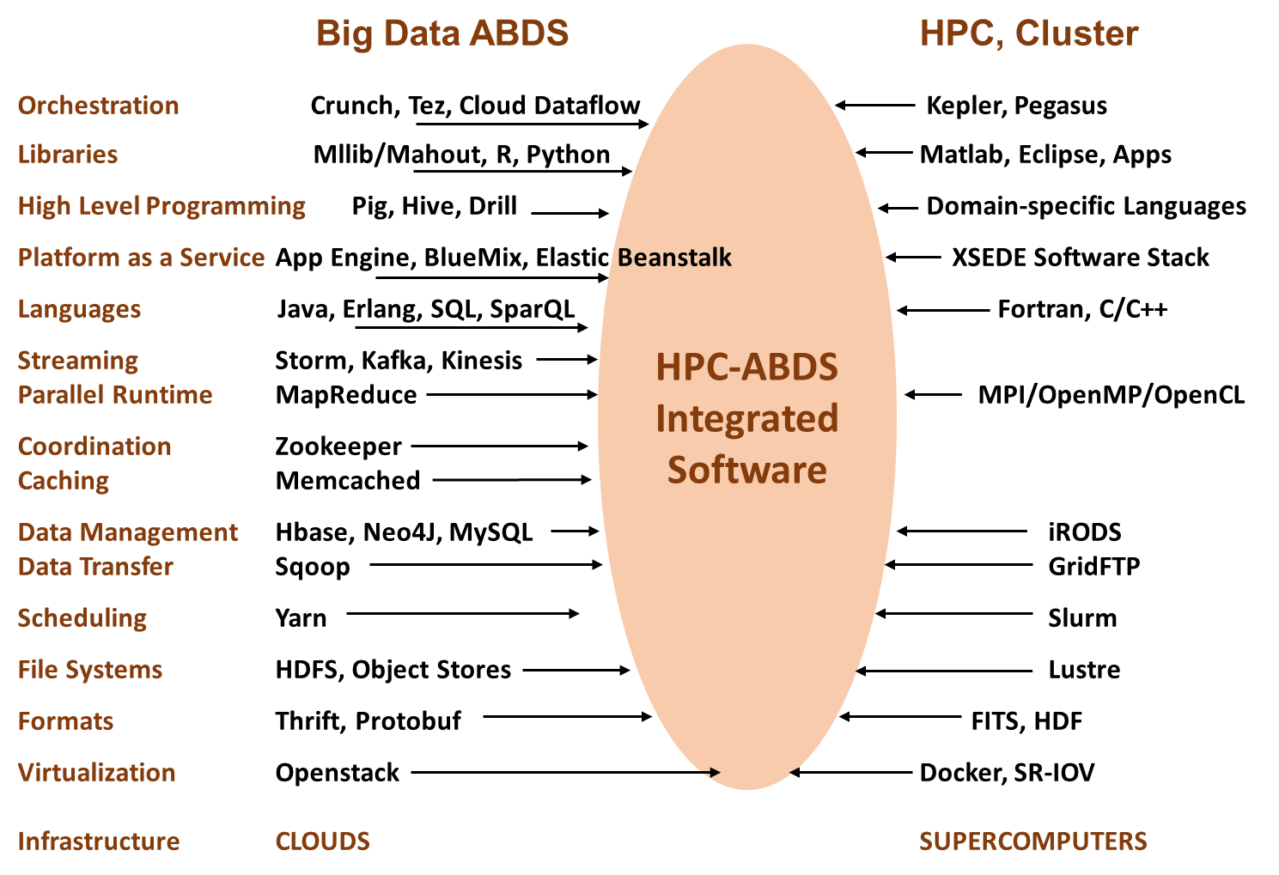

Slide 49
Software for a Big Data Initiative
Functionality of ABDS and Performance of HPC
Workflow: Apache Crunch, Python or Kepler
Data Analytics: Mahout, R, ImageJ, Scalapack
High level Programming: Hive, Pig
Batch Parallel Programming model: Hadoop, Spark, Giraph, Harp, MPI;
Streaming Programming model: Storm, Kafka or RabbitMQ
In-memory: Memcached
Data Management: Hbase, MongoDB, MySQL
Distributed Coordination: Zookeeper
Cluster Management: Yarn, Slurm
File Systems: HDFS, Object store (Swift),Lustre
DevOps: Cloudmesh, Chef, Puppet, Docker, Cobbler
IaaS: Amazon, Azure, OpenStack, Docker, SR-IOV
Monitoring: Inca, Ganglia, Nagios

Slide 50
Facets in the Execution Features Views

Slide 51
One View of Ogres has Facets that are micropatterns or Execution Features
Performance Metrics; property found by benchmarking Ogre
Flops per byte; memory or I/O
Execution Environment; Core libraries needed: matrix-matrix/vector algebra, conjugate gradient, reduction, broadcast; Cloud, HPC etc.
Volume: property of an Ogre instance
Velocity: qualitative property of Ogre with value associated with instance
Variety: important property especially of composite Ogres
Veracity: important property of “mini-applications” but not kernels
Communication Structure; Interconnect requirements; Is communication BSP, Asynchronous, Pub-Sub, Collective, Point to Point?
Is application (graph) static or dynamic?
Most applications consist of a set of interconnected entities; is this regular as a set of pixels or is it a complicated irregular graph?
Are algorithms Iterative or not?
Data Abstraction: key-value, pixel, graph(G3), vector, bags of words or items
Are data points in metric or non-metric spaces?
Is algorithm O(N²) or O(N) (up to logs) for N points per iteration (G2)

Slide 52
Facets of the Ogres Data Source and Style Aspects

Slide 53
Data Source and Style View of Ogres I
SQL NewSQL or NoSQL: NoSQL includes Document, Column, Key-value, Graph, Triple store; NewSQL is SQL redone to exploit NoSQL performance
Other Enterprise data systems: 10 examples from NIST integrate SQL/NoSQL
Set of Files or Objects: as managed in iRODS and extremely common in scientific research
File systems, Object, Blob and Data-parallel (HDFS) raw storage: Separated from computing or colocated? HDFS v Lustre v. Openstack Swift v. GPFS
Archive/Batched/Streaming: Streaming is incremental update of datasets with new algorithms to achieve real-time response (G7); Before data gets to compute system, there is often an initial data gathering phase which is characterized by a block size and timing. Block size varies from month (Remote Sensing, Seismic) to day (genomic) to seconds or lower (Real time control, streaming)
Notes:
Big dwarfs are Ogres
Implement Ogres in ABDS+

Slide 54
Data Source and Style View of Ogres II
Shared/Dedicated/Transient/Permanent: qualitative property of data; Other characteristics are needed for permanent auxiliary/comparison datasets and these could be interdisciplinary, implying nontrivial data movement/replication
Metadata/Provenance: Clear qualitative property but not for kernels as important aspect of data collection process
Internet of Things: 24 to 50 Billion devices on Internet by 2020
HPC simulations: generate major (visualization) output that often needs to be mined
Using GIS: Geographical Information Systems provide attractive access to geospatial data Note 10 Bob Marcus (led NIST effort) Use cases
Notes:
Big dwarfs are Ogres
Implement Ogres in ABDS+

Slide 55
2. Perform real time analytics on data source streams and notify users when specified events occur
Specify filter
Filter Identifying Events
Fetch streamed Data
Post Selected Events
Streaming Data
Posted Data
Identified Events
Streaming Data
Streaming Data
Archive
Repository
Storm, Kafka, Hbase, Zookeeper

Slide 56



5. Perform interactive analytics on data in analytics-optimized database
Mahout, R
Hadoop, Spark, Giraph, Pig …
Data Storage: HDFS, Hbase
Data, Streaming, Batch …..

Slide 57
5A. Perform interactive analytics on observational scientific data
Science Analysis Code, Mahout, R
Grid or Many Task Software, Hadoop, Spark, Giraph, Pig …
Data Storage: HDFS, Hbase, File Collection
Direct Transfer
Transport batch of data to primary analysis data system
Streaming Twitter data for Social Networking
Local Accumulate and initial computing
NIST examples include LHC, Remote Sensing, Astronomy and Bioinformatics
Record Scientific Data in “field”

Slide 58
Facets of the Ogres Processing View

Slide 59
Facets in Processing (run time) View of Ogres I
Micro-benchmarks ogres that exercise simple features of hardware such as communication, disk I/O, CPU, memory performance
Local Analytics executed on a single core or perhaps node
Global Analytics requiring iterative programming models (G5,G6) across multiple nodes of a parallel system
Optimization Methodology: overlapping categories
Nonlinear Optimization (G6)
Machine Learning
Maximum Likelihood or χ² minimizations
Expectation Maximization (often Steepest descent)
Combinatorial Optimization
Linear/Quadratic Programming (G5)
Dynamic Programming
Visualization is key application capability with algorithms like MDS useful but it itself part of “mini-app” or composite Ogre
Alignment (G7) as in BLAST compares samples with repository
Notes:
Big dwarfs are Ogres
Implement Ogres in ABDS+

Slide 60
Facets in Processing (run time) View of Ogres II
Streaming divided into 5 categories depending on event size and synchronization and integration
Set of independent events where precise time sequencing unimportant.
Time series of connected small events where time ordering important.
Set of independent large events where each event needs parallel processing with time sequencing not critical
Set of connected large events where each event needs parallel processing with time sequencing critical.
Stream of connected small or large events to be integrated in a complex way.
Basic Statistics (G1): MRStat in NIST problem features
Search/Query/Index: Classic database which is well studied (Baru, Rabl tutorial)
Recommender Engine: core to many e-commerce, media businesses; collaborative filtering key technology
Classification: assigning items to categories based on many methods
MapReduce good in Alignment, Basic statistics, S/Q/I, Recommender, Calssification
Deep Learning of growing importance due to success in speech recognition etc.
Problem set up as a graph (G3) as opposed to vector, grid, bag of words etc.
Using Linear Algebra Kernels: much machine learning uses linear algebra kernels
Notes:
Big dwarfs are Ogres
Implement Ogres in ABDS+

Slide 61
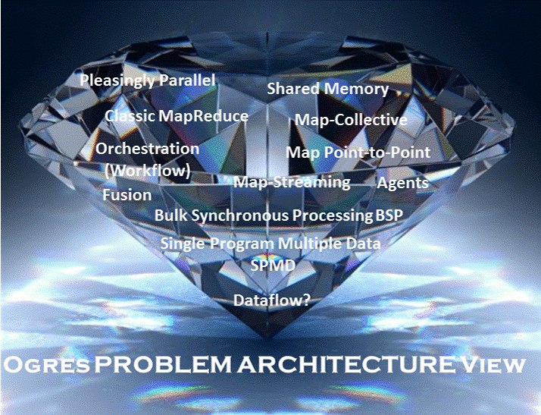

Slide 62
Benchmarks based on Ogres Analytics

Slide 63
Core Analytics Ogre Instances (microPattern) I
Map-Only
Pleasingly parallel - Local Machine Learning
MapReduce: Search/Query/Index
Summarizing statistics as in LHC Data analysis (histograms) (G1)
Recommender Systems (Collaborative Filtering)
Linear Classifiers (Bayes, Random Forests)
Alignment and Streaming (G7)
Genomic Alignment, Incremental Classifiers
Global Analytics
Nonlinear Solvers (structure depends on objective function) (G5,G6)
Stochastic Gradient Descent SGD
(L-)BFGS approximation to Newton’s Method
Levenberg-Marquardt solver

Slide 64
Core Analytics Ogre Instances (microPattern) II
Map-Collective (See Mahout, MLlib) (G2,G4,G6)
Often use matrix-matrix,-vector operations, solvers (conjugate gradient)
Outlier Detection, Clustering (many methods),
Mixture Models, LDA (Latent Dirichlet Allocation), PLSI (Probabilistic Latent Semantic Indexing)
SVM and Logistic Regression
PageRank, (find leading eigenvector of sparse matrix)
SVD (Singular Value Decomposition)
MDS (Multidimensional Scaling)
Learning Neural Networks (Deep Learning)
Hidden Markov Models

Slide 65
Core Analytics Ogre Instances (microPattern) III
Global Analytics – Map-Communication (targets for Giraph) (G3)
Graph Structure (Communities, subgraphs/motifs, diameter, maximal cliques, connected components)
Network Dynamics - Graph simulation Algorithms (epidemiology)
Global Analytics – Asynchronous Shared Memory (may be distributed algorithms)
Graph Structure (Betweenness centrality, shortest path) (G3)
Linear/Quadratic Programming, Combinatorial Optimization, Branch and Bound (G5)

Slide 66
Benchmarks/Mini-apps spanning Facets
Look at NSF SPIDAL Project, NIST 51 use cases, Baru-Rabl review
Catalog facets of benchmarks and choose entries to cover “all facets”
Micro Benchmarks: SPEC, EnhancedDFSIO (HDFS), Terasort, Wordcount, Grep, MPI, Basic Pub-Sub ….
SQL and NoSQL Data systems, Search, Recommenders: TPC (-C to x–HS for Hadoop), BigBench, Yahoo Cloud Serving, Berkeley Big Data, HiBench, BigDataBench, Cloudsuite, Linkbench
includes MapReduce cases Search, Bayes, Random Forests, Collaborative Filtering
Spatial Query: select from image or earth data
Alignment: Biology as in BLAST
Streaming: Online classifiers, Cluster tweets, Robotics, Industrial Internet of Things, Astronomy; BGBenchmark; choose to cover all 5 subclasses
Pleasingly parallel (Local Analytics): as in initial steps of LHC, Pathology, Bioimaging (differ in type of data analysis)
Global Analytics: Outlier, Clustering, LDA, SVM, Deep Learning, MDS, PageRank, Levenberg-Marquardt, Graph 500 entries
Workflow and Composite (analytics on xSQL) linking above

Slide 67
Parallel Data Analytics Issues

Slide 68
Remarks on Parallelism I
Most use parallelism over items in data set
Entities to cluster or map to Euclidean space
Except deep learning (for image data sets)which has parallelism over pixel plane in neurons not over items in training set
as need to look at small numbers of data items at a time in Stochastic Gradient Descent SGD
Need experiments to really test SGD – as no easy to use parallel implementations tests at scale NOT done
Maybe got where they are as most work sequential
Maximum Likelihood or χ² both lead to structure like
Minimize sum ∑_{items=1}^{N} (Positive nonlinear function of unknown parameters for item i)
All solved iteratively with (clever) first or second order approximation to shift in objective function
Sometimes steepest descent direction; sometimes Newton
11 billion deep learning parameters; Newton impossible
Have classic Expectation Maximization structure
Steepest descent shift is sum over shift calculated from each point
SGD – take randomly a few hundred of items in data set and calculate shifts over these and move a tiny distance
Classic method – take all (millions) of items in data set and move full distance

Slide 69
Remarks on Parallelism II
Need to cover non vector semimetric and vector spaces for clustering and dimension reduction (N points in space)
MDS Minimizes Stress σ(X) = Σ_{i<j=1}^{N} weight(i,j) (δ(i, j) - d(X_{i} , X_{j}))²
Semimetric spaces just have pairwise distances defined between points in space δ(i, j)
Vector spaces have Euclidean distance and scalar products
Algorithms can be O(N) and these are best for clustering but for MDS O(N) methods may not be best as obvious objective function O(N²)
Important new algorithms needed to define O(N) versions of current O(N²) – “must” work intuitively and shown in principle
Note matrix solvers all use conjugate gradient – converges in 5-100 iterations – a big gain for matrix with a million rows. This removes factor of N in time complexity
Ratio of #clusters to #points important; new ideas if ratio >~ 0.1

Slide 70
Algorithm Challenges
See NRC Massive Data Analysis report
O(N) algorithms for O(N²) problems
Parallelizing Stochastic Gradient Descent
Streaming data algorithms – balance and interplay between batch methods (most time consuming) and interpolative streaming methods
Graph algorithms
Machine Learning Community uses parameter servers; Parallel Computing (MPI) would not recommend this?
Is classic distributed model for “parameter service” better?
Apply best of parallel computing – communication and load balancing – to Giraph/Hadoop/Spark
Are data analytics sparse?; many cases are full matrices
BTW Need Java Grande – Some C++ but Java most popular in ABDS, with Python, Erlang, Go, Scala (compiles to JVM) …..

Slide 71
Lessons / Insights
Proposed classification of Big Data applications with features generalized as facets and kernels for analytics
Data intensive algorithms do not have the well developed high performance libraries familiar from HPC
Challenges with O(N²) problems
Global Machine Learning or (Exascale Global Optimization) particularly challenging
Develop SPIDAL (Scalable Parallel Interoperable Data Analytics Library)
New algorithms and new high performance parallel implementations
Integrate (don’t compete) HPC with “Commodity Big data” (Google to Amazon to Enterprise/Startup Data Analytics)
i.e. improve Mahout; don’t compete with it
Use Hadoop plug-ins rather than replacing Hadoop
Enhanced Apache Big Data Stack HPC-ABDS has ~290 members with HPC opportunities at Resource management, Storage/Data, Streaming, Programming, monitoring, workflow layers.

